Slide 1

Project Title -
Seasonal Agriculture Performance Analysis
Student Name:
College Name:
PARINITHA R S
ANAND INSTITUTE OF HIGHER TECHNOLOGY
AICTE STU ID :
STU6842c22f6f0561749205551

Slide 2

PROBLEM STATEMENT
Agricultural activities are influenced by seasonal variations in environmental conditions, farming practices, resource availability and market conditions. As a result, agricultural performance may differ from one season to another.
However, raw agricultural data does not clearly explain how agricultural performance changes across seasons or what patterns can be observed in different seasonal conditions.
The problem is to analyze the given agricultural dataset and investigate seasonal differences in agricultural performance by identifying meaningful patterns, trends, relationships and variations within the available data.

Slide 3
Project Description
Seasonal Agriculture Performance Analysis is a data analytics project that analyzes agricultural performance across different seasons, geographical regions, crops, environmental conditions, resource usage, and economic factors. The project aims to transform raw agricultural data into meaningful insights by identifying seasonal patterns, variations, relationships, and unusual observations.
The project involves data exploration, cleaning, preprocessing, statistical analysis, and visualization to understand how agricultural production changes across seasons. It examines crop and regional performance, environmental factors such as rainfall, temperature, and humidity, and resource requirements such as water, fertilizer, and labor. Economic factors such as revenue, cost, and profit are also analyzed to understand seasonal economic performance.
Statistical techniques such as correlation analysis and ANOVA are used to investigate relationships between variables and determine whether differences in agricultural performance across seasons are statistically significant. Outlier and anomaly analysis is performed to identify unusual agricultural observations that may require further investigation. A machine learning-based feature importance analysis is also used to identify important numerical factors associated with agricultural production.
The final outcome of the project is to provide evidence-based insights and data-driven recommendations that can support better understanding of seasonal agricultural performance and contribute to improved seasonal agricultural planning.

Slide 4

WHO ARE THE END USERS?
The main end users of this project are:
Farmers – to understand seasonal crop performance and make better farming decisions.
Agricultural planners – to support evidence-based seasonal agricultural planning.
Agricultural researchers – to study seasonal patterns, environmental conditions, and crop performance.
Government and agricultural organizations – to understand regional and seasonal agricultural trends for planning and resource allocation.
Agricultural analysts and students – to explore agricultural data and identify meaningful trends, relationships, and variations.

Slide 5

Technology Used
Programming Language: Python
Data Analysis: Pandas, NumPy
Data Visualization: Matplotlib, Seaborn
Statistical Analysis: SciPy
Machine Learning: Scikit-learn
Development Environment: Google Colab
Data Storage & Input: CSV / Excel datasets

Slide 6
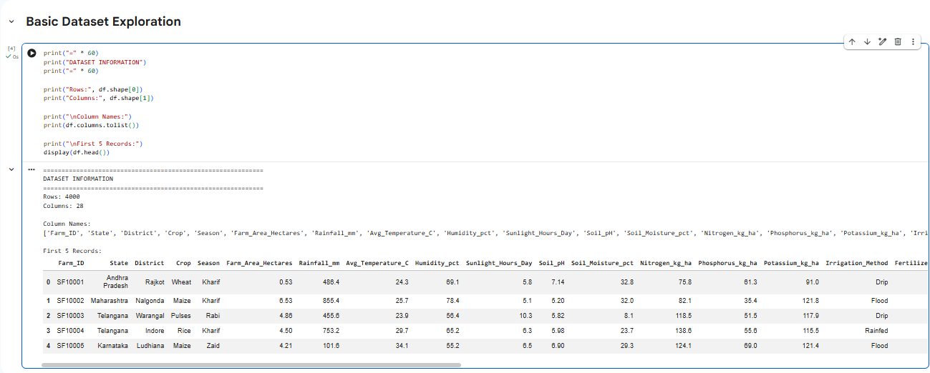
RESULTS

Slide 7
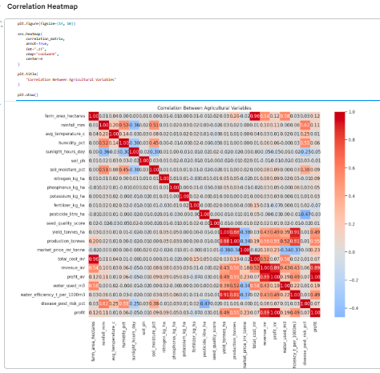
RESULTS

Slide 8
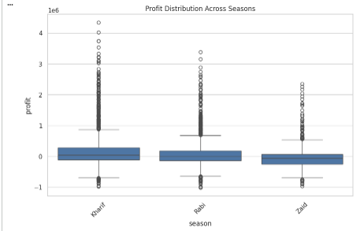
RESULTS
📊 Short Explanation
Kharif: Highest variability and highest profit outliers (>4 million).
Rabi: Moderate variability with high-profit outliers (~3.3 million).
Zaid: Lower typical profit with fewer extreme values.
Outliers: Show unusually high profits and some losses.
Overall: Kharif has the strongest and most variable profit performance, while Zaid is comparatively lower.

Slide 9
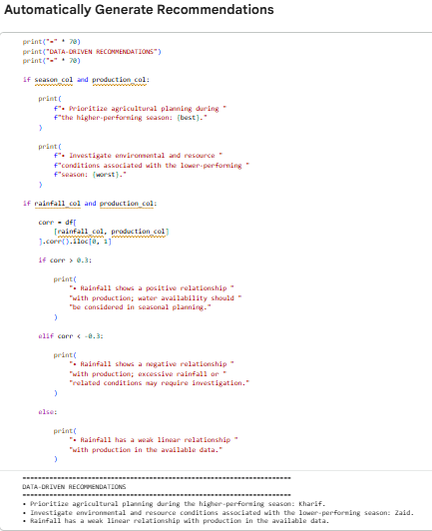
RESULTS

Slide 10
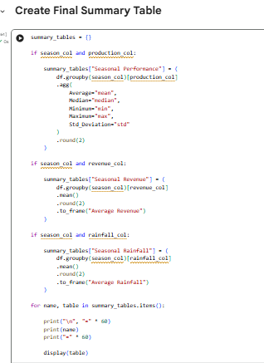
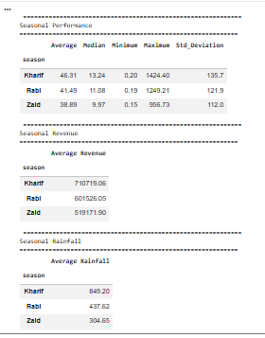
RESULTS

Slide 11
Future scope
The project can be further enhanced by integrating real-time agricultural and weather data to improve seasonal analysis and prediction.
Machine learning models can be developed to predict crop production and identify the factors that most influence agricultural performance.
The system can also be extended with interactive dashboards for farmers, agricultural researchers, and planners to monitor seasonal trends and regional performance.
Future work may include crop recommendation, yield forecasting, resource optimization, and early identification of unfavorable agricultural conditions. These improvements can support more effective, data-driven seasonal agricultural planning.

Slide 12
GitHub Link
https://github.com/Parinitha1506/Seasonal-Agriculture-Performance-Analysis.git

Slide 13
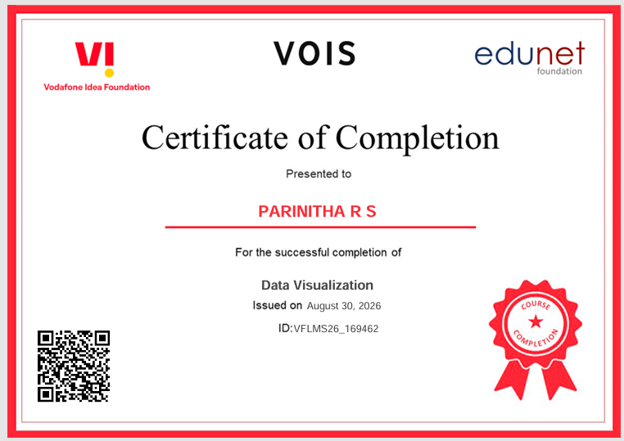
VOIS Course completion certificate - Course name- Data Visualization

Slide 14
Thank you
.
.

